Slide 1

Logistic regression

Slide 2
Logistic Regression
Logistic regression solves supervised learning problem for qualitative (categorical) output
Logistic regression solves classification problem
Logistic regression is a parametric approach

Slide 3
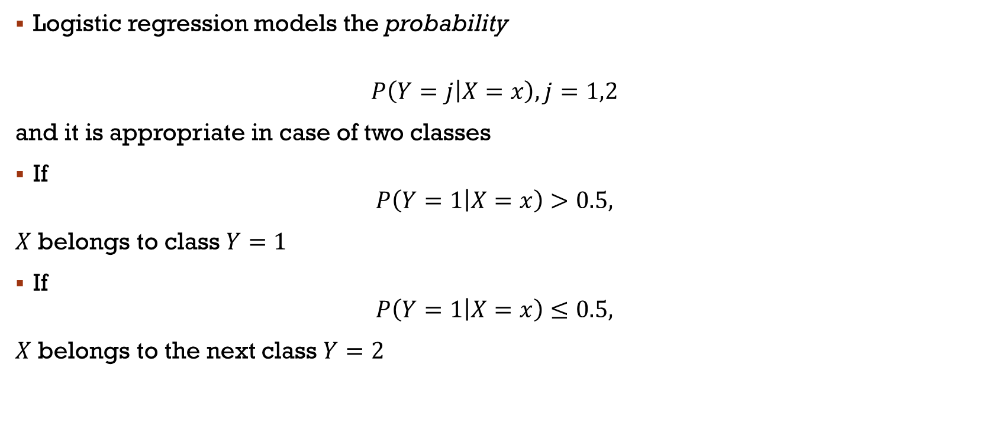
Logistic Regression
Logistic regression models the probability
$$P\left(Y=j | X=x\right), j=1,2$$
and it is appropriate in case of two classes
If
$$P\left(Y=1 | X=x\right)>0.5,$$
$X$ belongs to class $Y=1$
If
$$P\left(Y=1 | X=x\right)≤0.5,$$
$X$ belongs to the next class $Y=2$

Slide 4
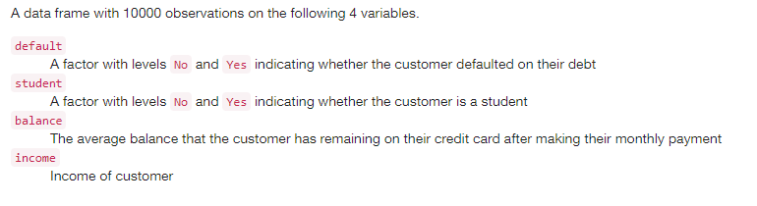
Default Data

Slide 5
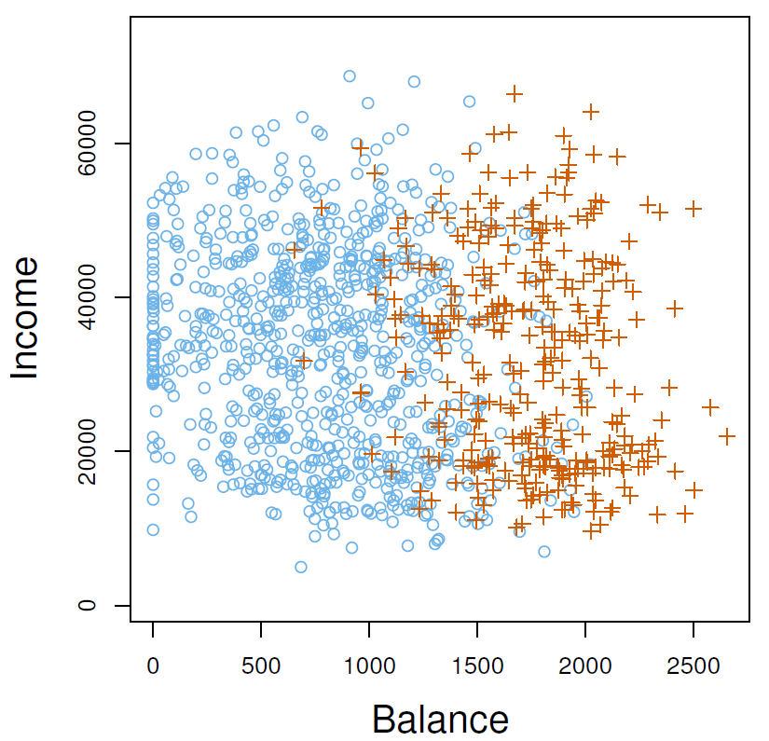
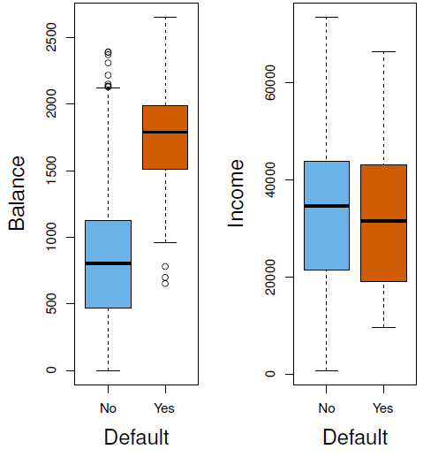
Default Data
We want to predict whether an individual will default on a card payment, on the basis of annual income and monthly credit card balance.

Slide 6
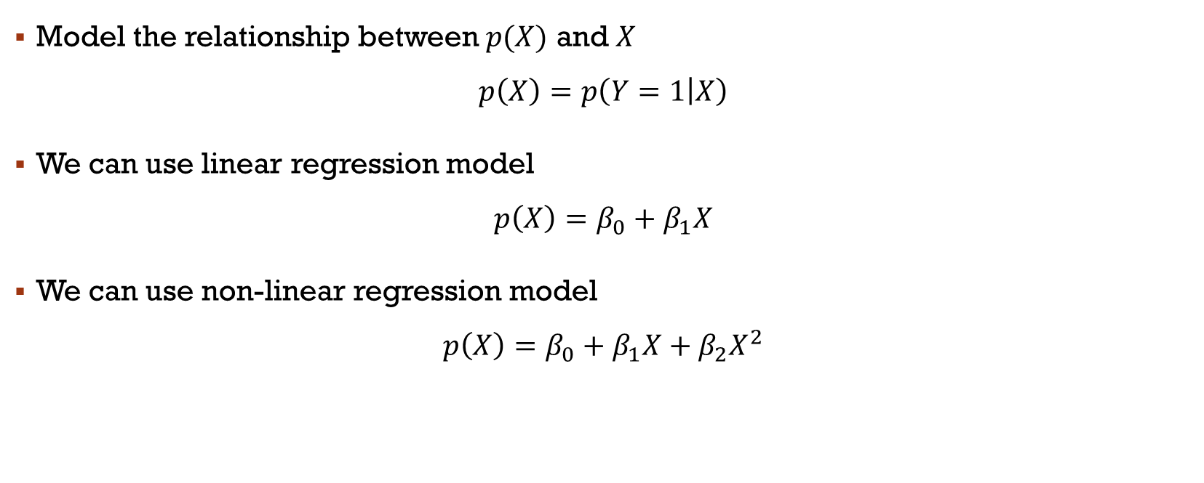
Logistic Model
Model the relationship between $p(X)$ and $X$
$$p\left(X\right)=p\left(Y=1 | X\right)$$
We can use linear regression model
$$p\left(X\right)=β_{0}+β_{1}X$$
We can use non-linear regression model
$$p\left(X\right)=β_{0}+β_{1}X+β_{2}X^{2}$$

Slide 7

Logistic Model
We use another model (the logistic function)
$$p\left(X\right)=\frac{e^{β_{0}+β_{1}X }}{1+e^{β_{0}+β_{1}X }}$$
$$0≤p\left(X\right)≤1$$

Slide 8
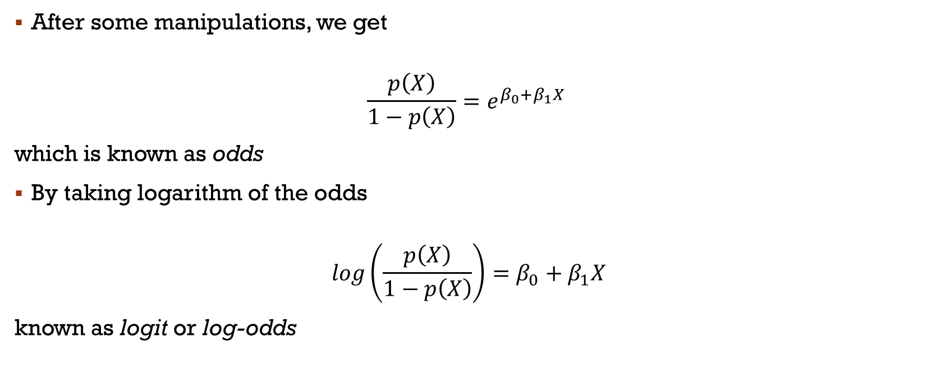
Logistic Model
After some manipulations, we get
$$\frac{p\left(X\right)}{1−p\left(X\right)}=e^{β_{0}+β_{1}X }$$
which is known as odds
By taking logarithm of the odds
$$log\left(\frac{p\left(X\right)}{1−p\left(X\right)}\right)=β_{0}+β_{1}X$$
known as logit or log-odds

Slide 9
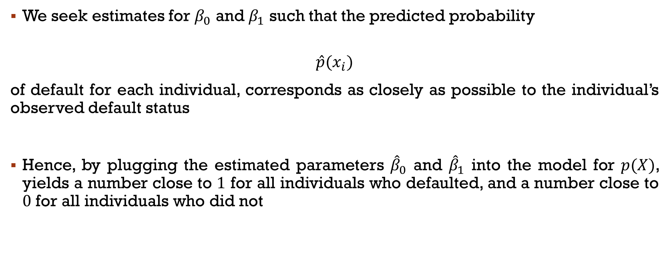
Parameter estimation
We seek estimates for $β_{0}$ and $β_{1}$ such that the predicted probability
$$\hat{p}(x_{i})$$
of default for each individual, corresponds as closely as possible to the individual’s observed default status
Hence, by plugging the estimated parameters ${\hat{β}}_{0}$ and ${\hat{β}}_{1}$ into the model for $p(X)$, yields a number close to $1$ for all individuals who defaulted, and a number close to $0$ for all individuals who did not

Slide 10
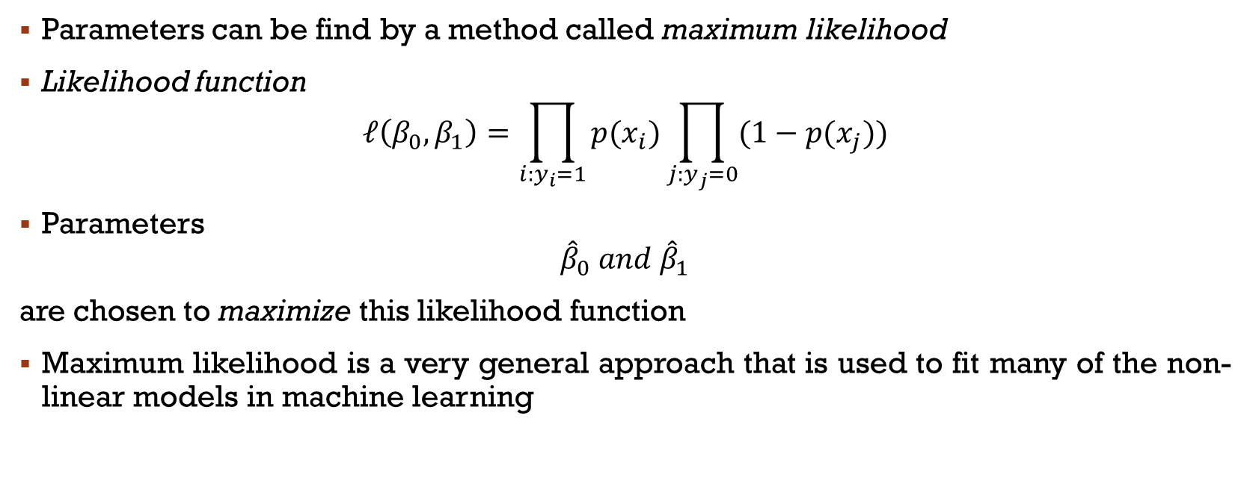
Parameter estimation
Parameters can be find by a method called maximum likelihood
Likelihood function
$$ℓ\left(β_{0},β_{1}\right)=\prod_{i:y_{i}=1}{p(x_{i})}\prod_{j:y_{j}=0}{(1−p(x_{j}))}$$
Parameters
$${\hat{β}}_{0} and {\hat{β}}_{1}$$
are chosen to maximize this likelihood function
Maximum likelihood is a very general approach that is used to fit many of the non-linear models in machine learning

Slide 11
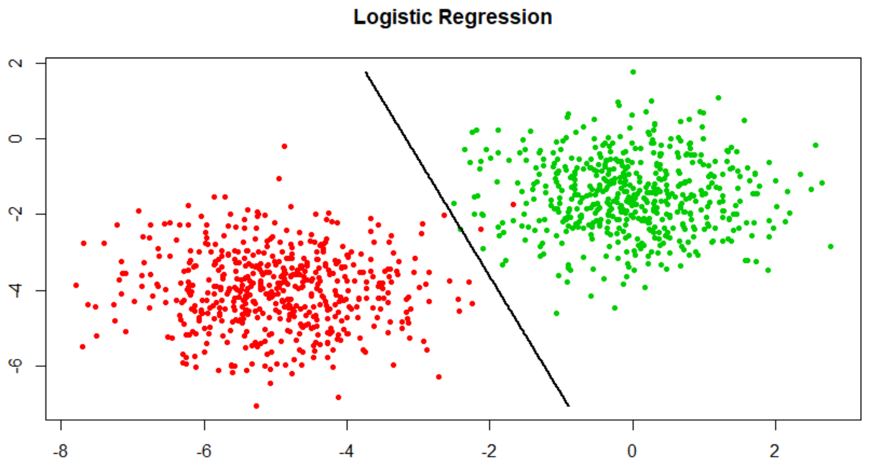
Example
Binary classification problem
Observations have 2 predictors
Classes are linearly separable
Only 2 misclassified points

Slide 12
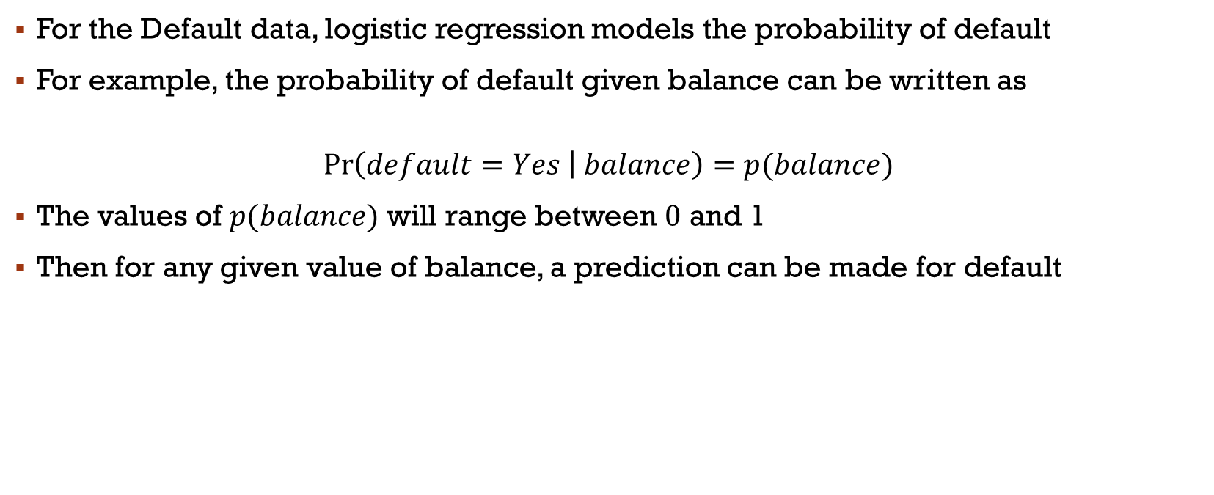
Default Data
For the Default data, logistic regression models the probability of default
For example, the probability of default given balance can be written as
$$\operatorname{Pr}\left(default=Yes | balance\right)=p(balance)$$
The values of $p(balance)$ will range between $0$ and 1
Then for any given value of balance, a prediction can be made for default

Slide 13
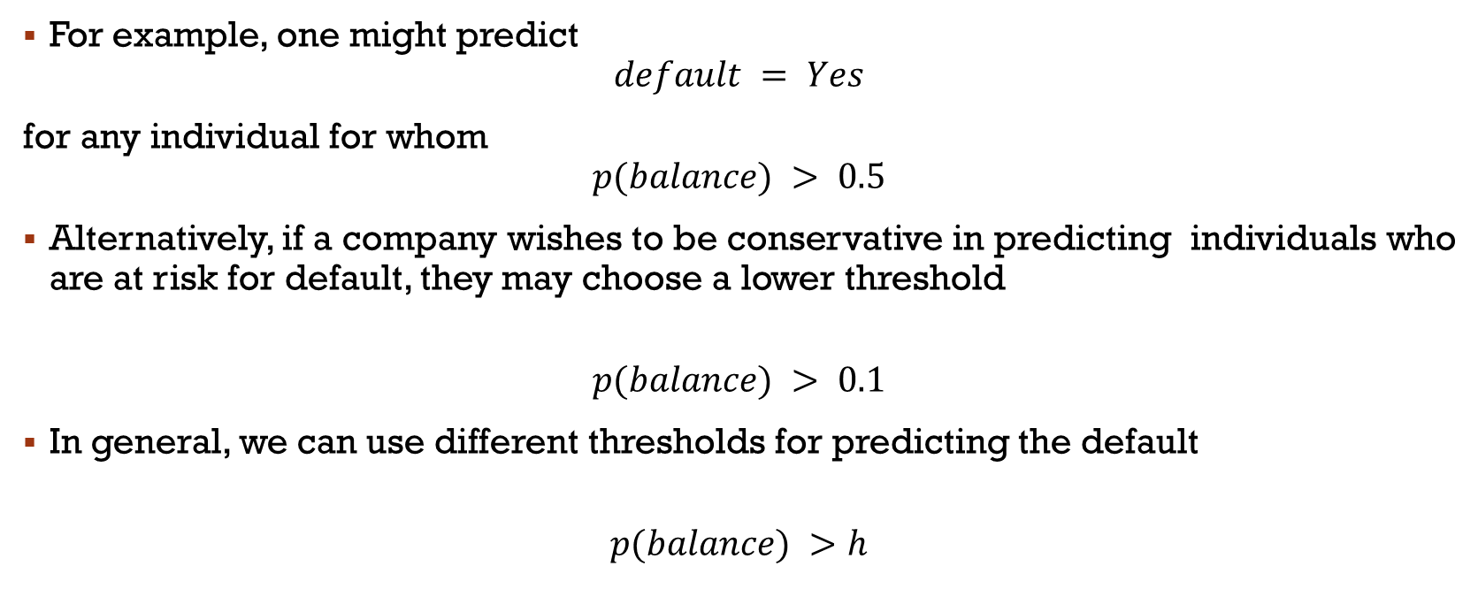
Default Data
For example, one might predict
$$default = Yes$$
for any individual for whom
$$p(balance) > 0.5$$
Alternatively, if a company wishes to be conservative in predicting individuals who are at risk for default, they may choose a lower threshold
$$p(balance) > 0.1$$
In general, we can use different thresholds for predicting the default
$$p(balance) >h$$

Slide 14
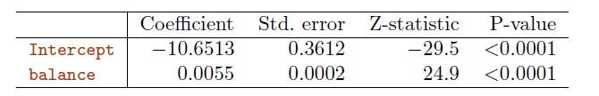
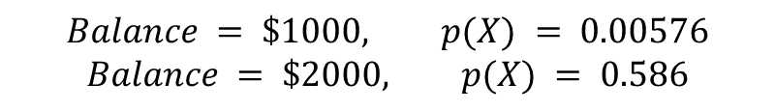
Logistic regression for default
We see that ${\hat{β}}_{1}=0.0055$ which indicates that an increase in balance is associated with an increase in the probability of default
$$Balance = \$1000, p(X) = 0.00576$$
$$Balance = \$2000, p(X) = 0.586$$

Slide 15
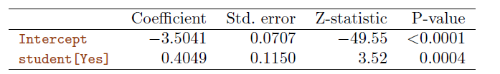
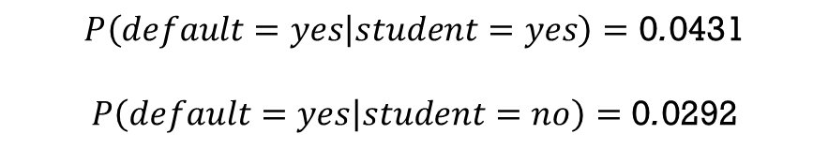
Logistic regression with qualitative predictors
$$P\left(default=yes | student=yes\right)=\text{0}\text{.}\text{0431}$$
$$P\left(default=yes | student=no\right)=\text{0}\text{.}\text{0292}$$
This indicates that students tend to have higher default probabilities than non-students

Slide 16

Multiple Logistic Regression
$$p\left(X\right)=P\left(Y=1 | X=x\right)=\frac{e^{β_{0}+β_{1}X_{1}+…+β_{s}X_{s}}}{1+e^{β_{0}+β_{1}X_{1}+…+β_{s}X_{s}}}, X=\left(X_{1},…,X_{s}\right)$$
$$log\left(\frac{p\left(X\right)}{1−p\left(X\right)}\right)=β_{0}+β_{1}X_{1}+…+β_{s}X_{s}$$

Slide 17
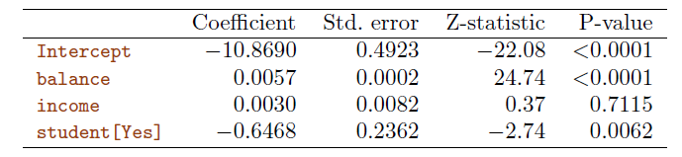
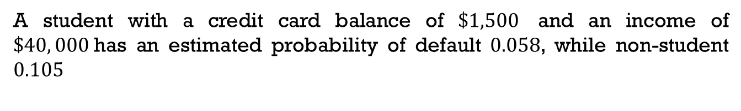
Multiple logistic regression
A student with a credit card balance of $\$1,500$ and an income of $\$40, 000$has an estimated probability of default $0.058$, while non-student $0.105$

Slide 18
Multiple logistic regression
Surprising result!
The coefficient for the student[Yes] is negative, indicating that students are less likely to default than non-students
How it is possible that in one table, the student status is associated with an increase in probability of default, and in the other table with a decrease in probability of default?

Slide 19
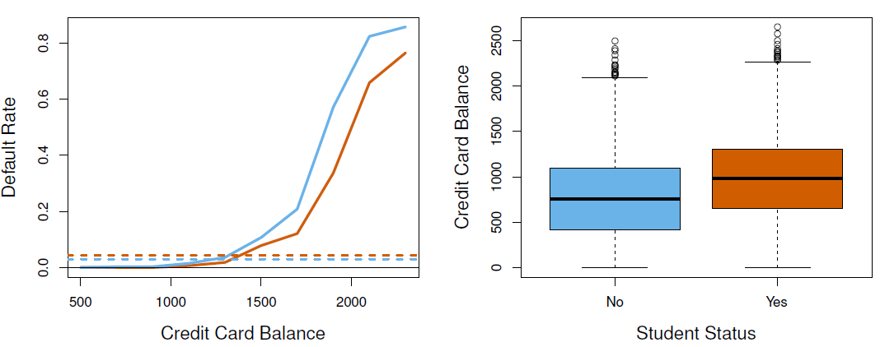
Confounding in the Default data
The orange and blue solid lines show the average default rates for students and non-students, respectively, as a function of credit card balance
The negative coefficient indicates that for a fixed value of balance and income, a student is less likely to default than a non-student
Horizontal broken lines display the overall default rates for students and non-students averaged over all values of balance and income
It suggests the opposite effect: the overall student default rate is higher than the non-student default rate
Consequently, there is a positive coefficient for student in the single variable output

Slide 20
Confounding in the Default data
A student is riskier than a non-student if no information about the student’s credit card balance is available
However, student is less risky than a non-student with the same credit card balance!
This phenomenon is known as confounding which is the result of correlations between different predictors

Slide 21
CV to Choose the Order of lr
Bayes’ Error Rate: 0.133

Slide 22
LR for classification
Error Rate: 0.201
Error Rate: 0.197
Bayes’ Error Rate: 0.133
Quadratic Logistic regression does better than linear

Slide 23
LR for classification
Error Rate: 0.160
Error Rate: 0.162
Bayes’ Error Rate: 0.133
Quartic regression is worse than the cubic

Slide 24
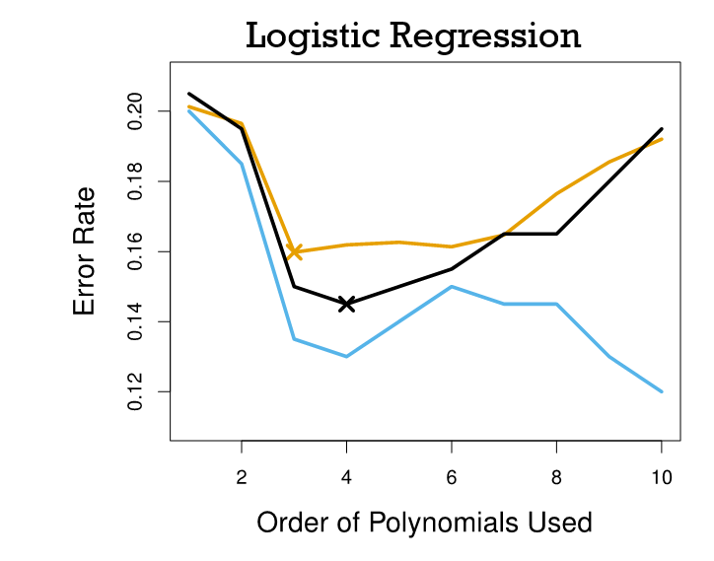
CV to Choose the Order
Brown: Test Error
Blue: Training Error
Black: 10-fold CV Error

Slide 25
Multi-class classification problem
The two-class logistic regression models have multiple-class extensions, but in practice they tend not to be used all that often
One of the reasons is that the method known as discriminant analysis, is popular for multiple-class classification
So we do not go into the details of multiple-class logistic regression
Simply note that such an approach is possible, and that software for it is available

